Slide 1


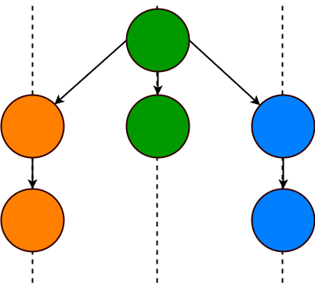


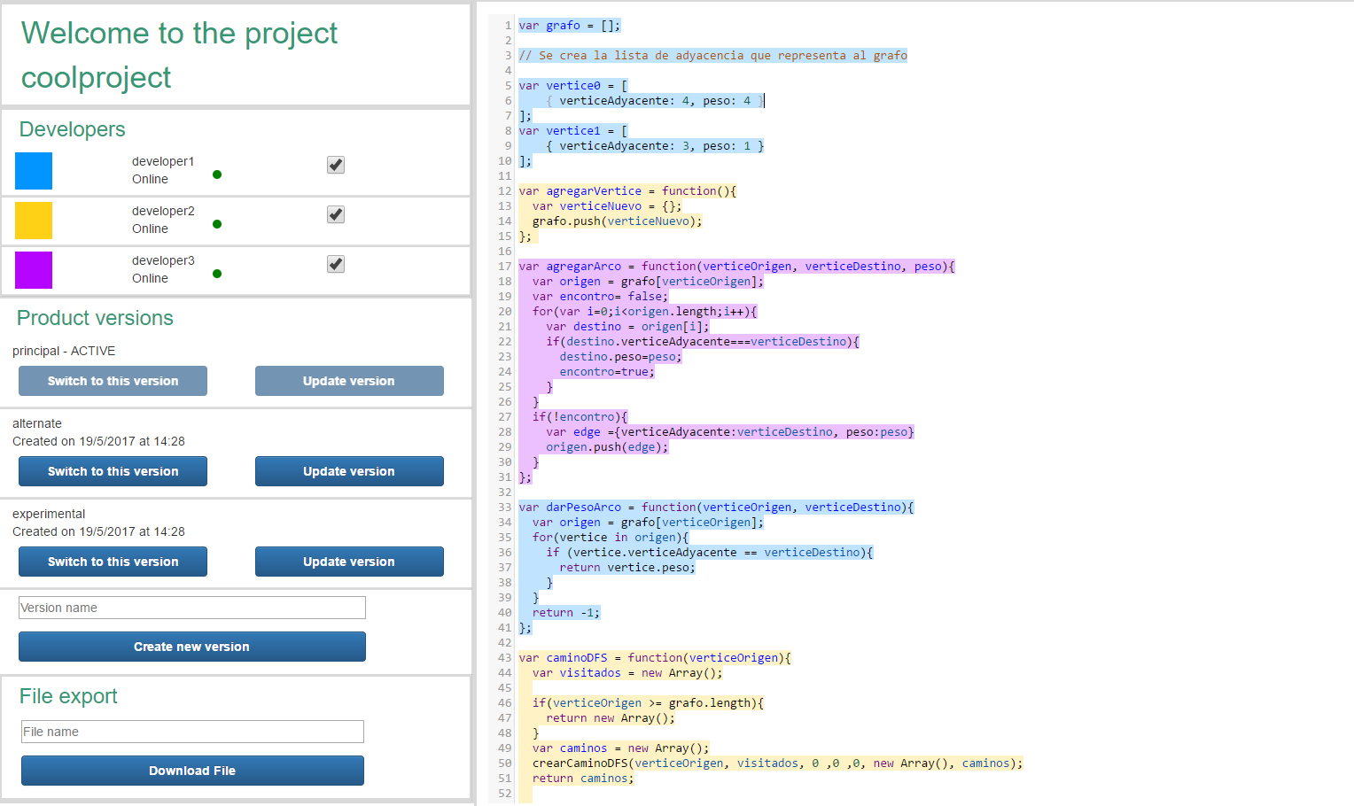
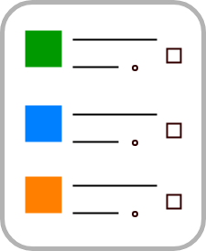




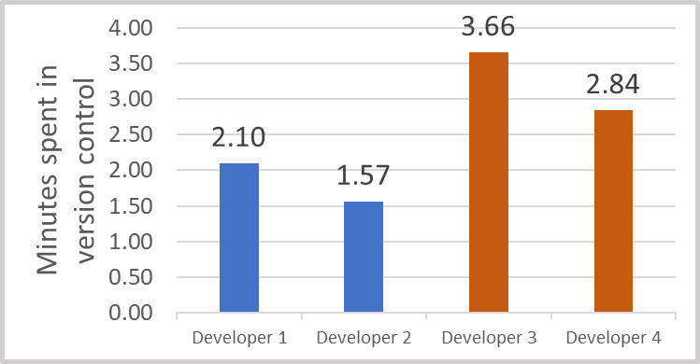

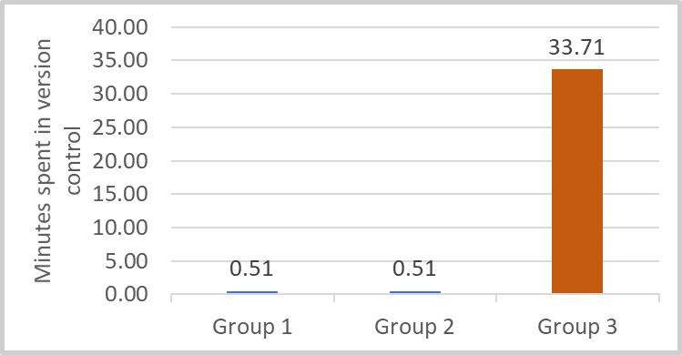


CollabIDE
Faculty of Engineering
Systems and Computing Engineering Department
Santiago Beltrán Caicedo(s.beltran10@uniandes.edu.co), Nicolás Cardozo (n.cardozo@uniandes.edu.co)
PROBLEM
Decrease in productivity caused by Overhead generated from interruptions of the coding workflow. These interruptions come from activities related to version control.
Build a collaborative IDE. The IDE must have features that reduce the Overhead generated by workflow interruptions. The requirements of the IDE: contribution management, version management and concurrent development
Contributions from various developers in a distributed development environment.
Product variants in software product lines.
How do we solve it?
Context oriented programming provides elements that are necessary for implementing the requirements of the IDE, mainly because handling different contexts (developers and product versions) must be done.
COP
CollabIDE
Contribution management
Version management
Concurrent development
¿Cómo solucionarlo?
Identifying authors of code fragments and the possibility of toggling which ones are active help in conflict resolution.
The time required for creating and switching between product versions is reduced. Every developer obtains a new product version the moment it is created by any developer.
Developers can view in real time all the changes made in the IDE (Product versions and code). This feature eliminates the need of constantly obtaining changes made by other developers.
Validation
CollabIDE
Another IDE
2 Experiments
Product variants development
+
VS
CollabIDE
The graphs show the time spent in version control for each experiment. In both cases the Overhead was reduced when using CollabIDE.
4 developers
+
VS
CollabIDE
Collaborative product development
3 groups – 2 developers per group
View it on Github
https://github.com/sbeltran10/collabIDE
About the author
https://sbeltran10.github.io/SantiagoBeltranHomePage

